Slide 1


Slide 2
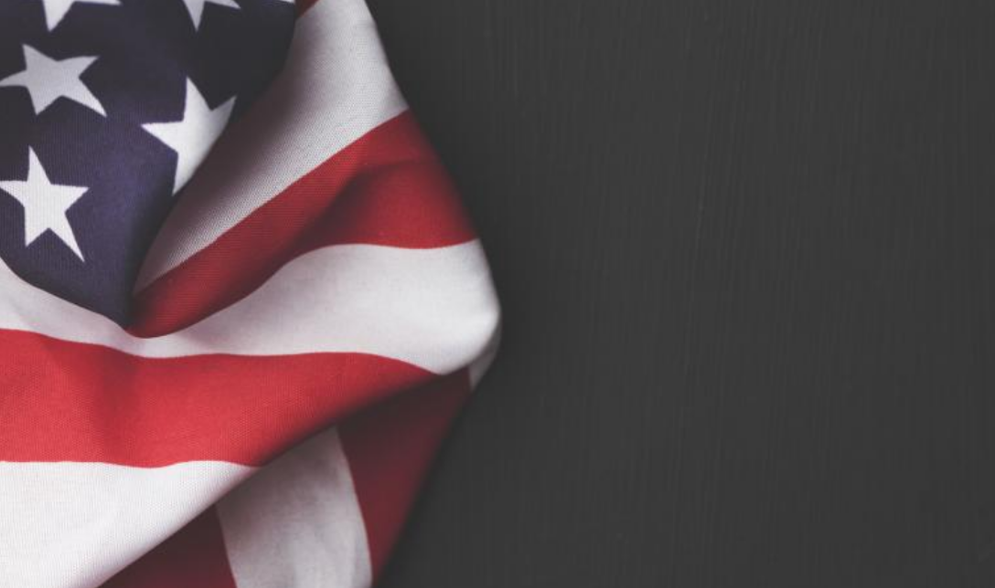
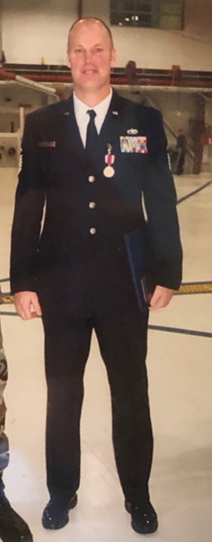
Garry Byers
US Air Force
Ohio Air
National Guard

Slide 3
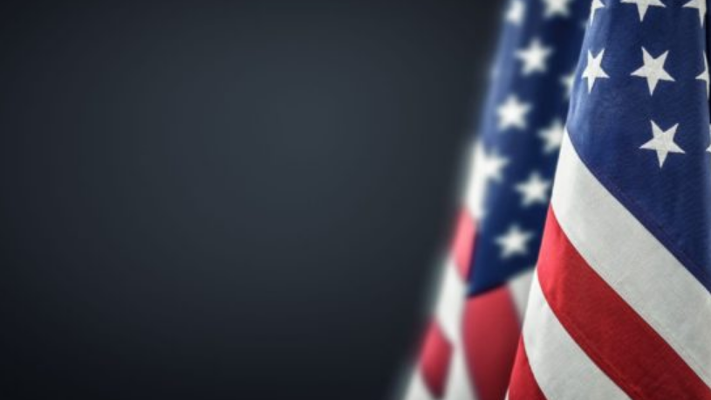
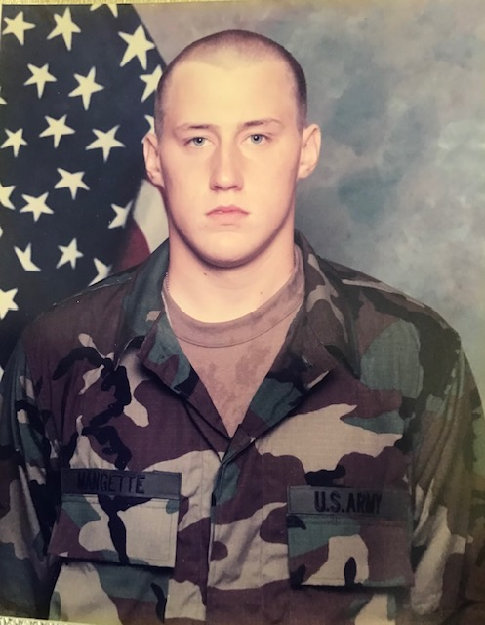
Kevin Mangette
US Army
Served from
1998-2002

Slide 4
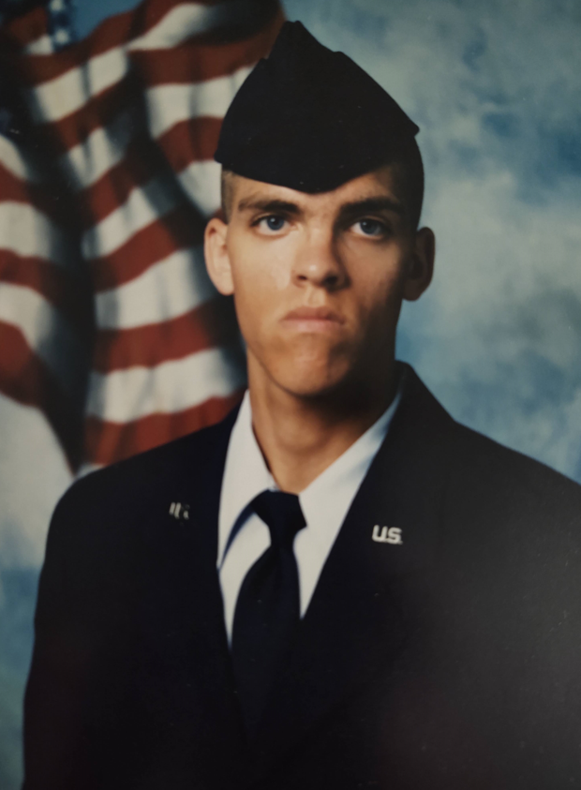
Pete Dery
US Air Force
Ohio Air
National Guard

Slide 5

Steve Silveous
US Air Force
Served from
1984-2008

Slide 6
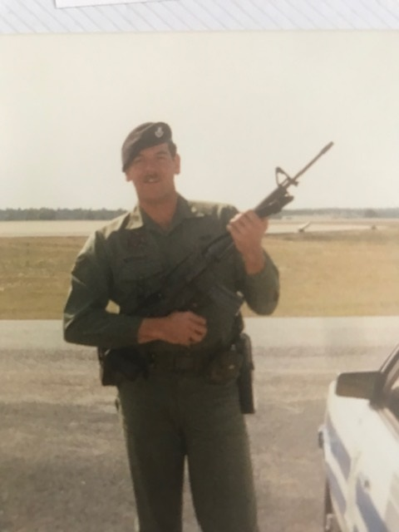
John Wismer
US Air Force
Ohio Air
National Guard

Slide 7
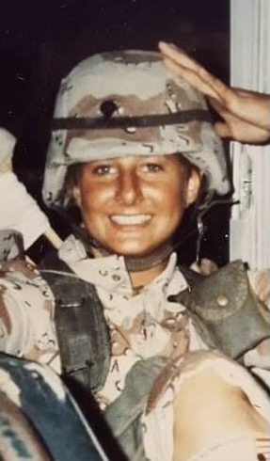
Jennifer Straka
US Army
Military Police

Slide 8
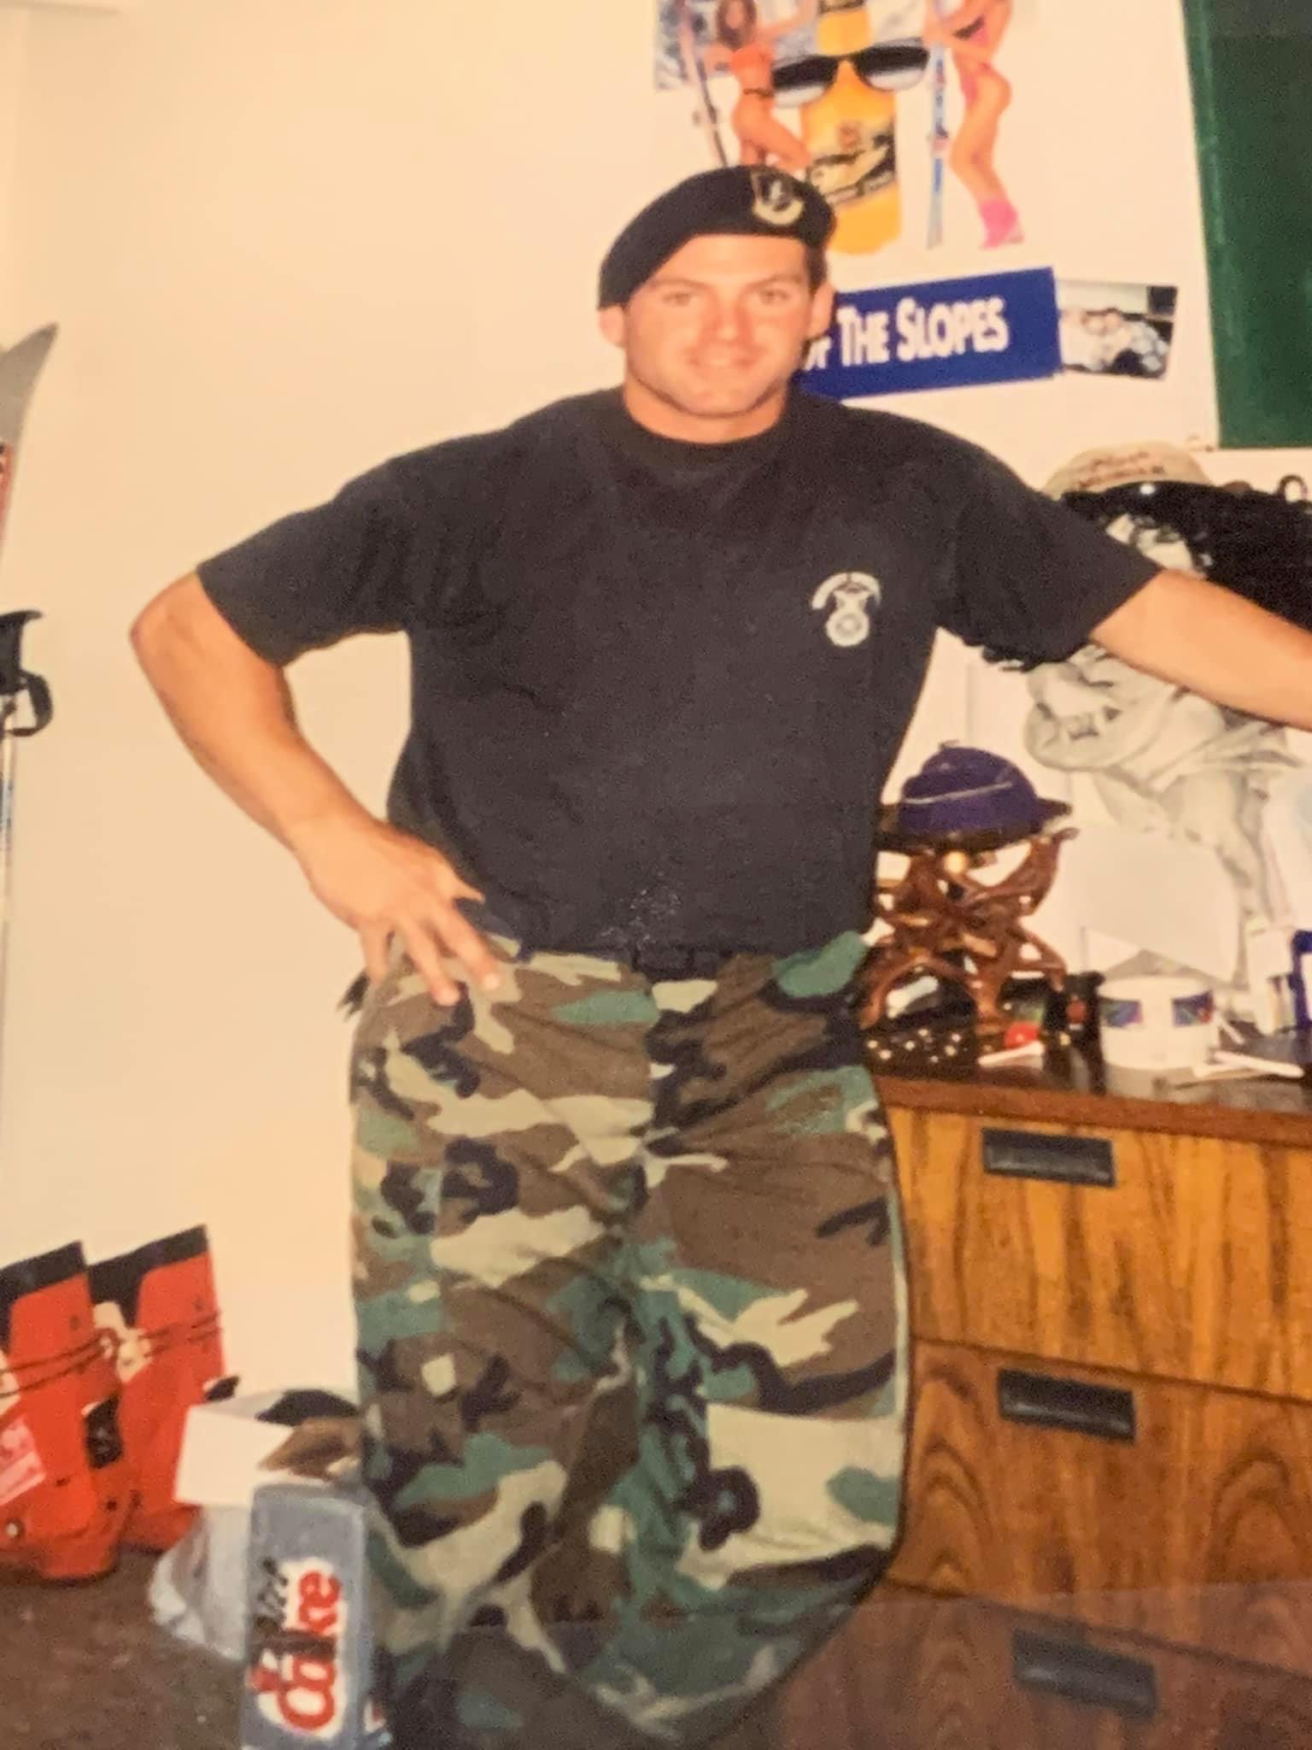
Dave Madigan
US Air Force
Served from
1996-1999

Slide 9
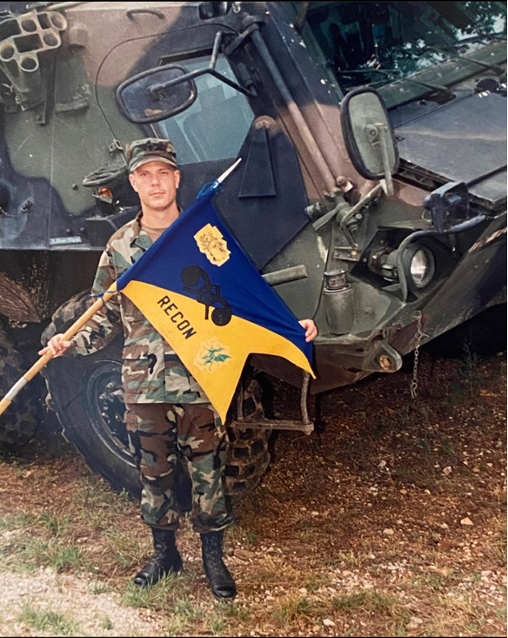
Che Brindle
US Army
Served from
2000-2004

Slide 10
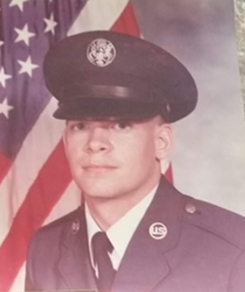
Paul Baker
US Air Force
Served from
1981-1985

Slide 11
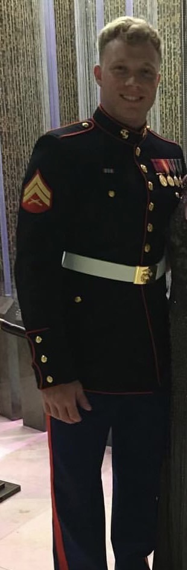
Ryan Hrabik
US Marines
Served from
2013-2017

Slide 12
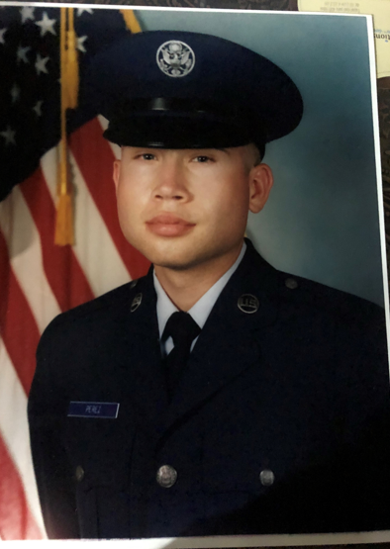
Mark Perez
US Air Force
Served from
1991-1995

Slide 13
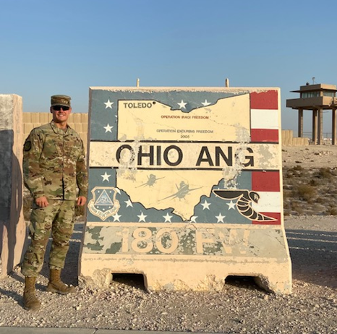
Travis Sumner
US Air Force
Ohio Air
National Guard

Slide 14
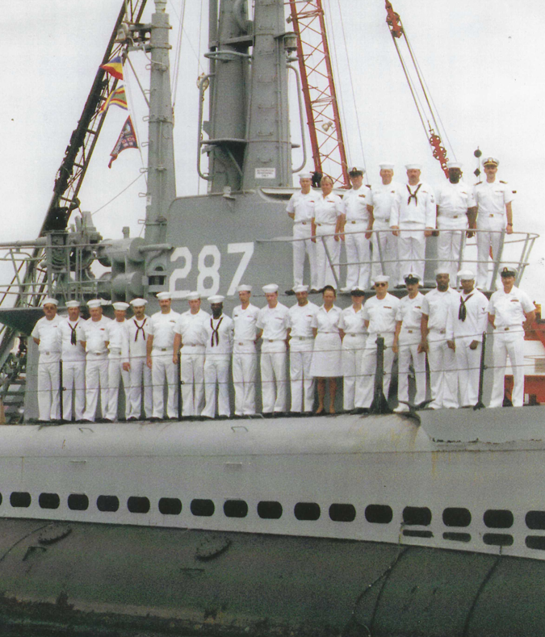
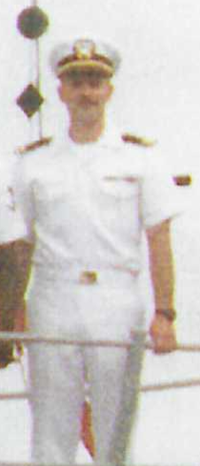
Jim Veglia
US Navy
Served from
1988-1998

Slide 15
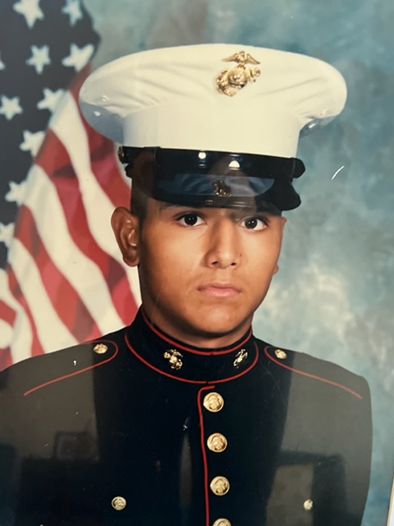
Gabe Pedroza
US Marines
Served from
1996-2002

Slide 16





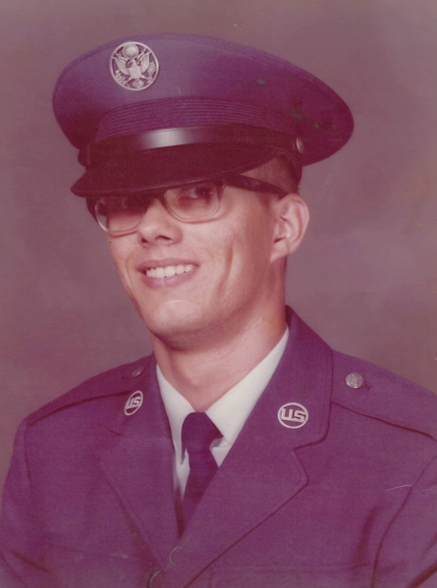
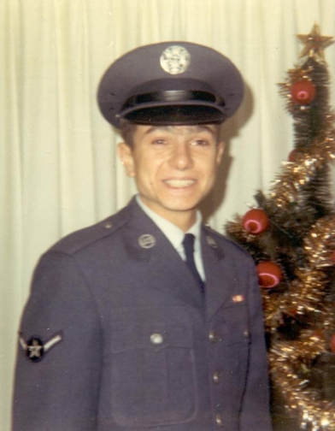
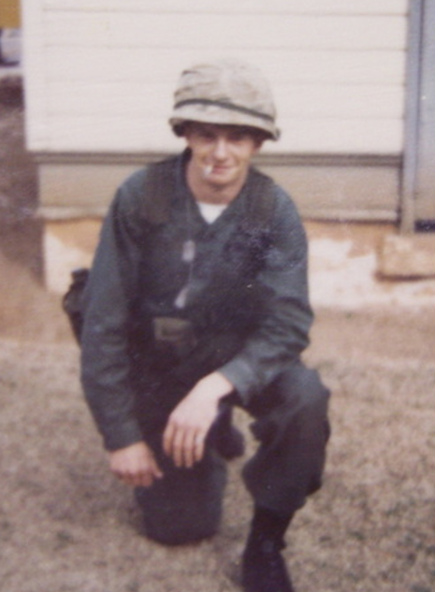
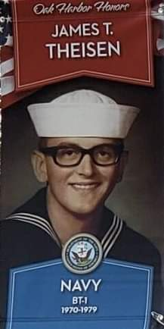
Honoring Toledo Edison Retirees who served
Steven Kirian
US Air Force
1976-1980
Peter John Seniuk
US Air Force
1970-1973
Raymond Zychowicz
US National Guard
1969--1975
James Thiesen
US Navy

Slide 17
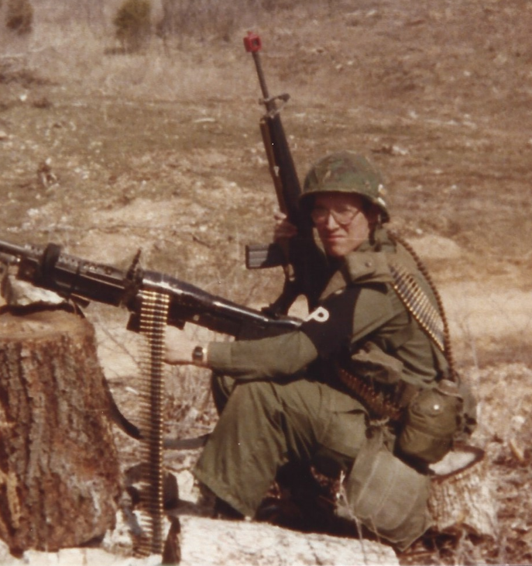
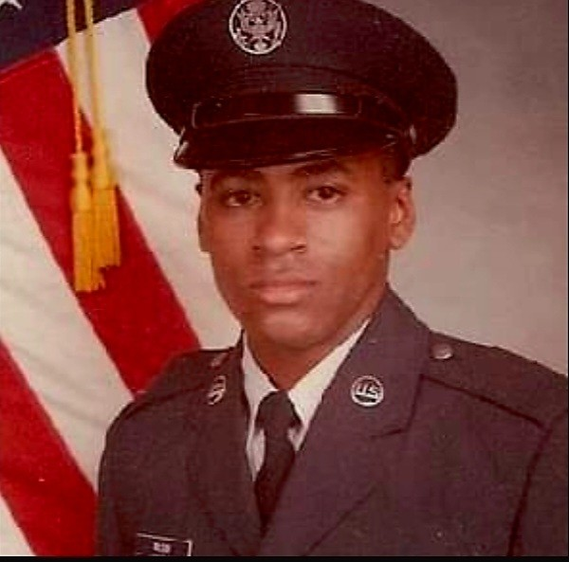
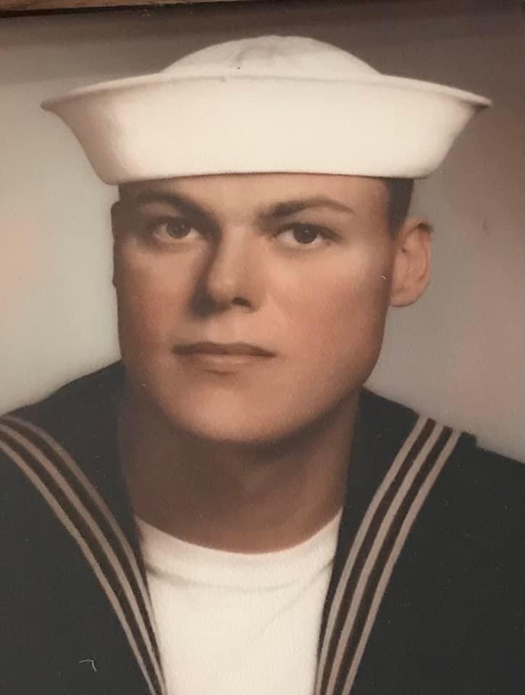
Honoring Toledo Edison Retirees who served
James Wilson
US Air Force
1984-1989
Bill O’Connor
US Navy
1968--1974
John Hammer
US Army
1977-1980

Slide 18
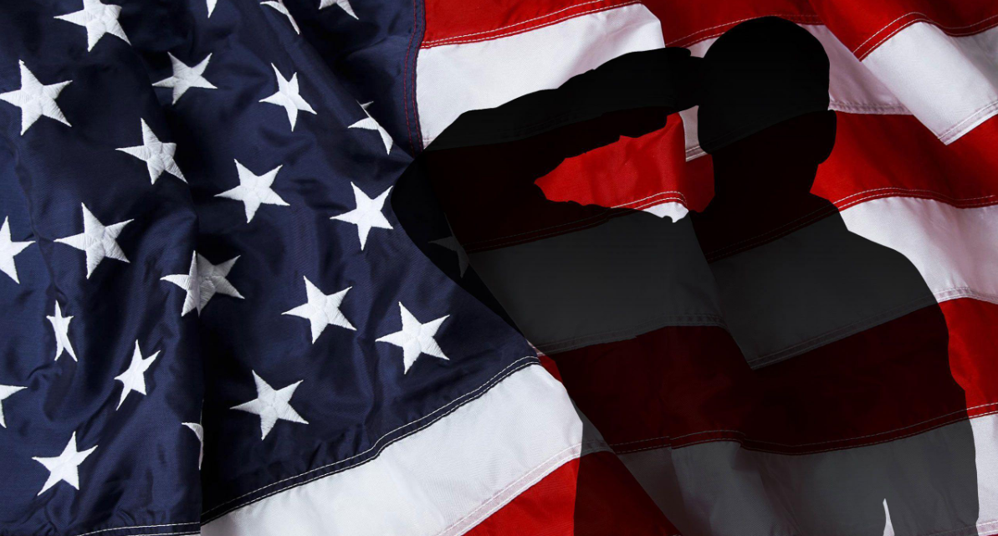

Thank You Veterans

